Slide 1
Personalized Schedule Planning Assistant Agent
ZHANG, Zhengyao
09/23/2024

Slide 2



Project Background
HKUST Independent Project collaborating with industrial partner AOVA
Engineering oriented project, more focus on application and implementation

Slide 3
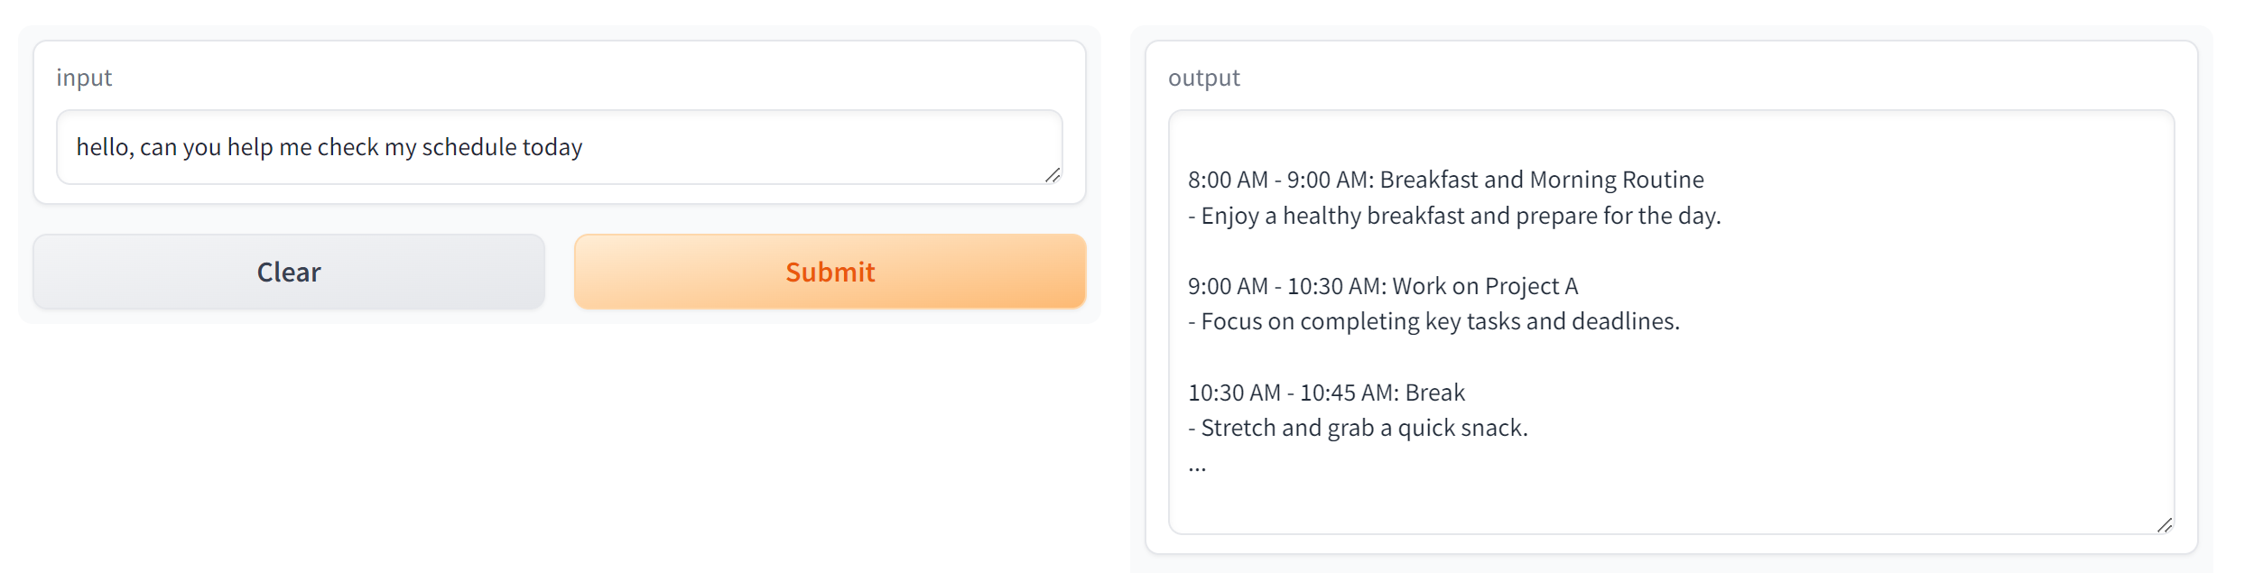
Initial Project Description
Implement a personal schedule planning assistant agent
Friendly User Interface and efficient Backend with RAG

Slide 4



Project Motivation
Personal Assistant is one fundamental requirement of an AI Agent
Schedule Planning Assistantship is one typical application scenario
Inspired by Iron Man
AVOA Product

Slide 5
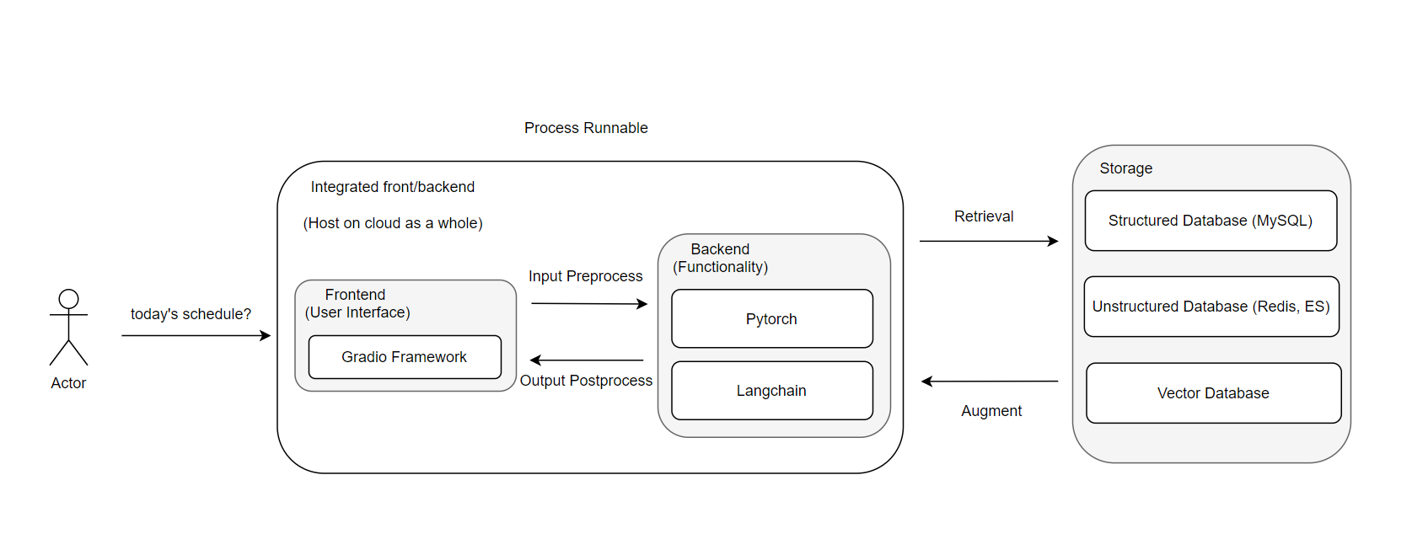
Initial Project Structure
Technique Stack mostly in Python (lib & framework)
LLM knowledge & RAG practice involved

Slide 6
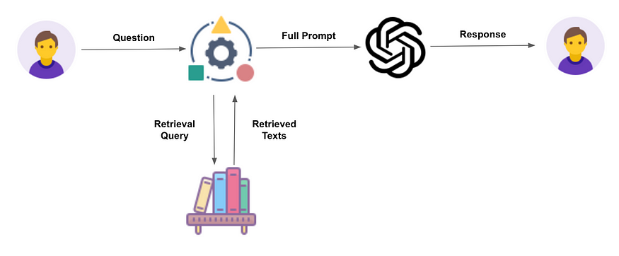
What is RAG
Idea of enhancing LLM performance with external knowledge resources
Achieve better performance with relative acceptable model size

Slide 7
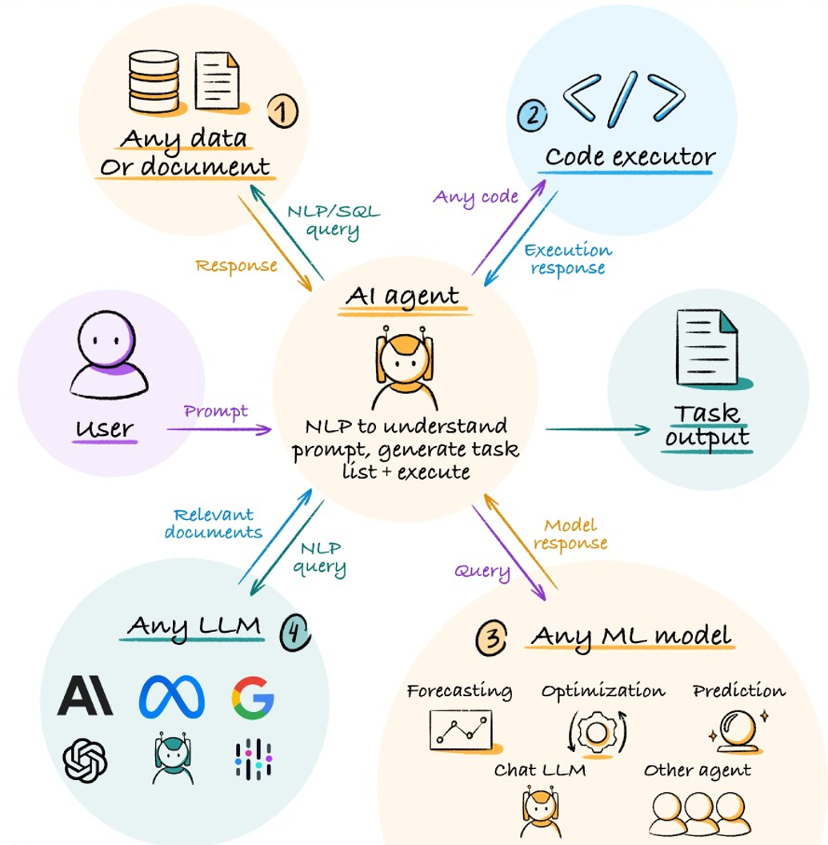
What is AI Agent
Encapsulation/Extension of general LLM functionality
Integration of RAG, RPC, LLM interfaces, etc...

Slide 8
Project Expected Outcome
Interactive AI Agent with user interface
Functionalities Video Demo / Live Demo
Acceptable LLM & RAG Performance
Metrics evaluation / Other LLM evaluation / ...

Slide 9
Project Workload Distribution
9/23 (2nd meeting) – 10/23 (3rd meeting)
Implementation of user interface, and skeleton of agent behavior
Some initial performance demo of agent on 3rd meeting
10/23 (3rd meeting) – 11/23 (4th meeting)
Optimize RAG performance, present some metrics evaluation
Optimize project structure and functionality (if things go well and time left)

Slide 10
Project Handout
Codebase
Organized on Github
Final Report
Project Setup / implementation details / results & performance / ...
Minutes
Notes and summaries of 4 meetings

